Slide 1
Chapter 3.4 Art of the Americas

Slide 2
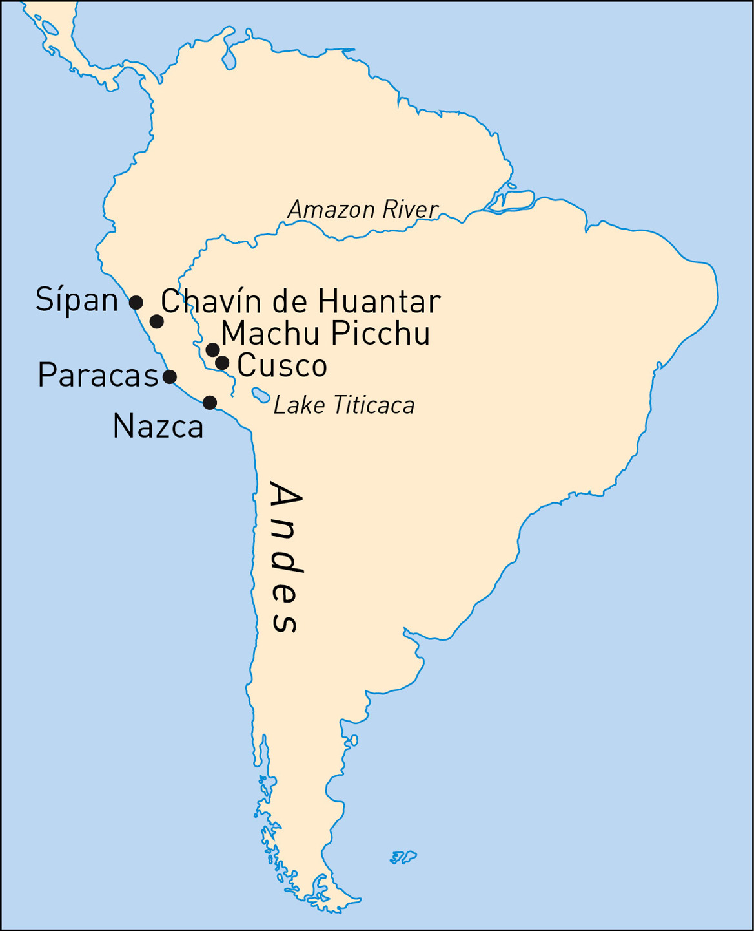
3.4.1 Map showing sites
of ancient South America

Slide 3
South America
From about 3000 bce, region around the Andes Mountains (present-day Peru and Bolivia)
Andean cultures: Chavín, Paracas, Nazca, Moche, Tiwanaku, and Inca
In contrast to other parts of the world, Andean peoples developed monumental architecture and textiles long before ceramics and intensive agriculture (two hallmarks of early civilization).
Art reflected the local environment, resources, and beliefs
Used stylized forms

Slide 4
The Chavín and the Paracas
Chavín culture is one of the oldest in South America (c. 900 bce). Located in the highlands.
Important pilgrimage center, marked by temples and stone monuments
Art features animals/ the cosmos. Home to a style of art that spread throughout the Andes.
Paracas people, on the coast of Peru.
Spectacular textiles

Slide 5
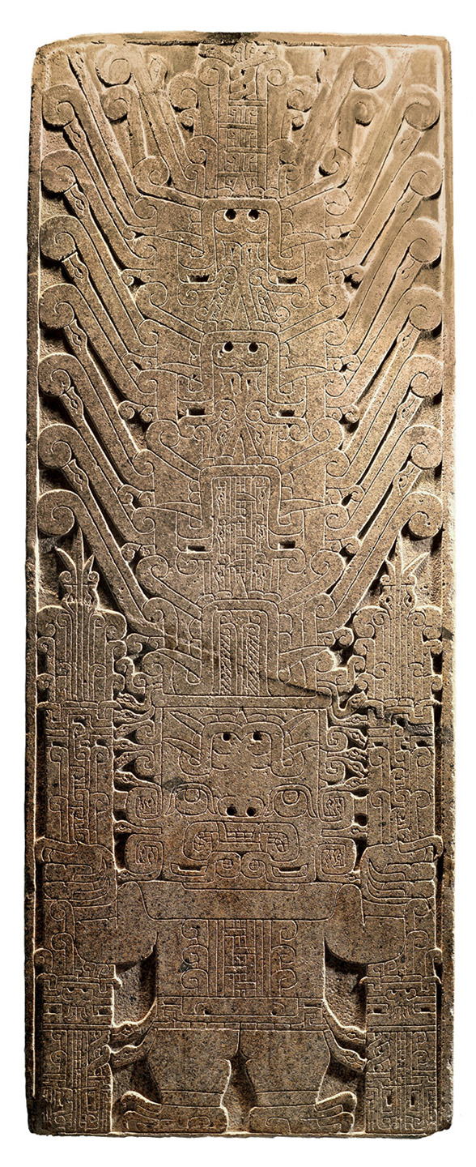
3.4.2a Raimondi Stela, Chavín de Huantar, 7th century bce. Granite, 6’5 × 2’5”. Museo Arqueología, Lima, Peru.
Depicts the staff god.

Slide 6
Raimondi Stela
Depicts deity with human/animal attributes
Lines describe more than one object at once (contour rivalry)
Upright: creature holds two staffs; elaborate headdress; looks up
Upside down: figure looks down over crocodile snout; double-faced

Slide 7
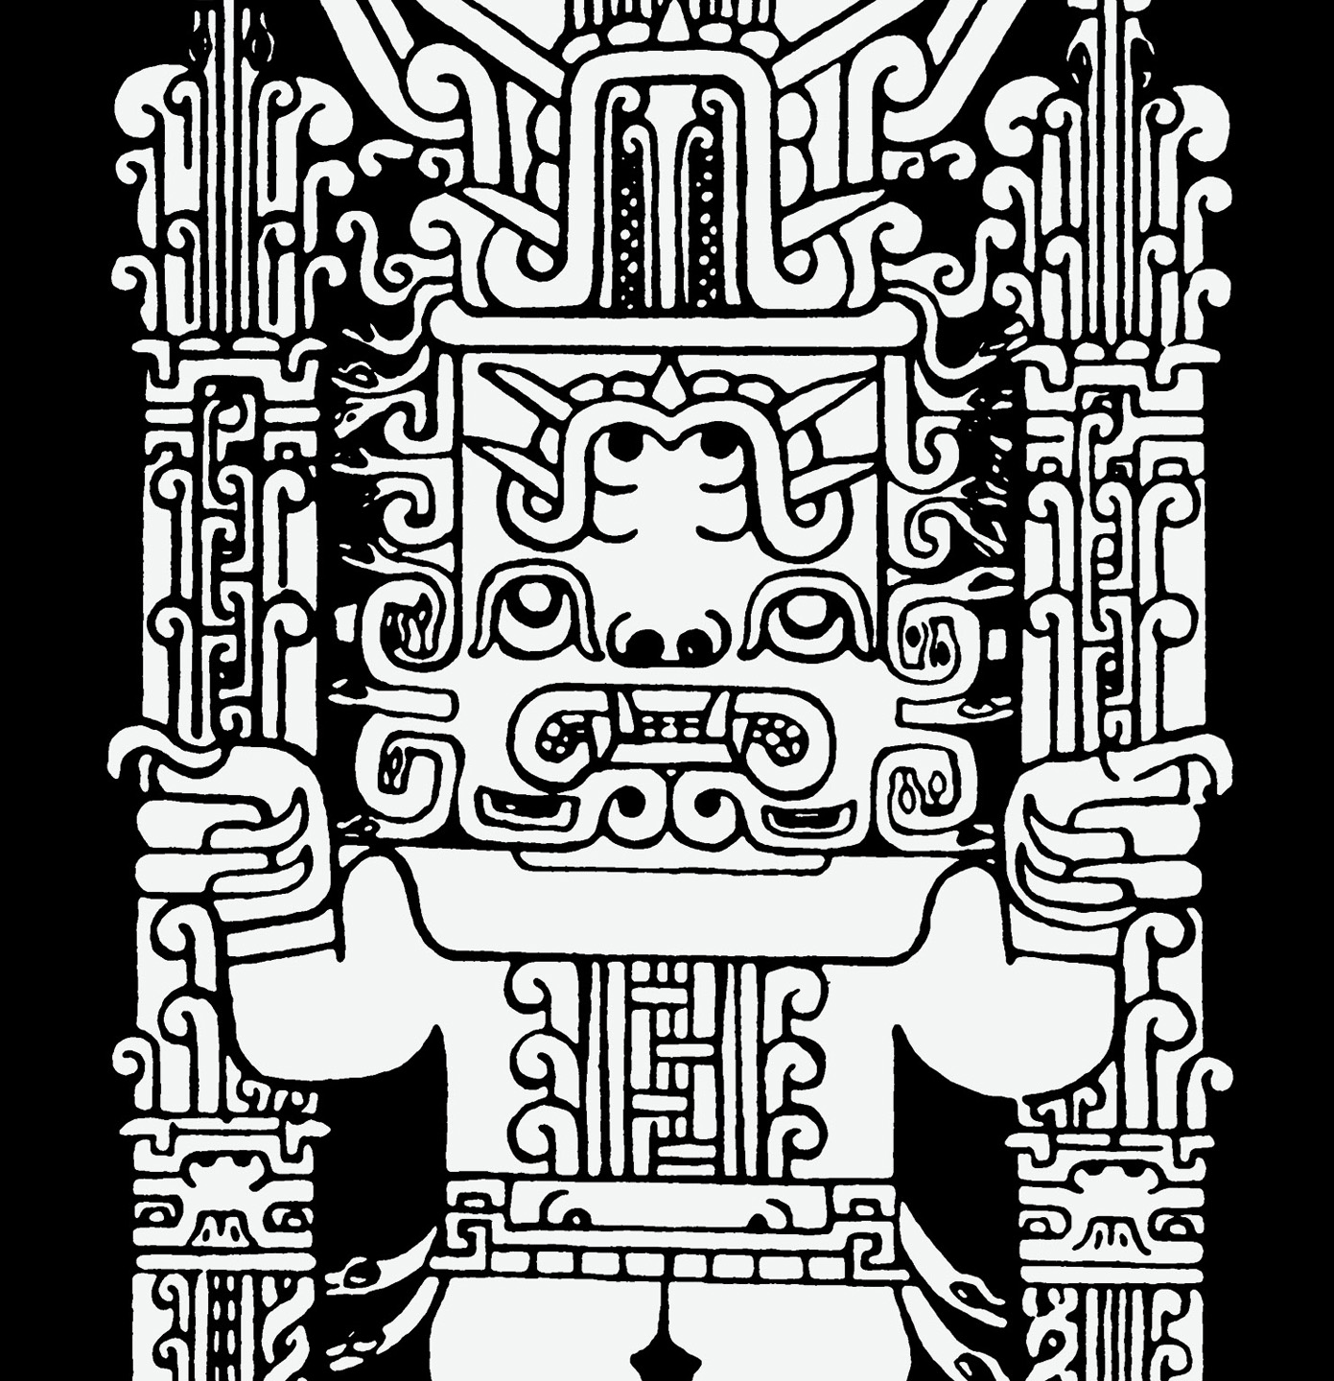
3.4.2b Drawing of detail from the Raimondi Stela

Slide 8
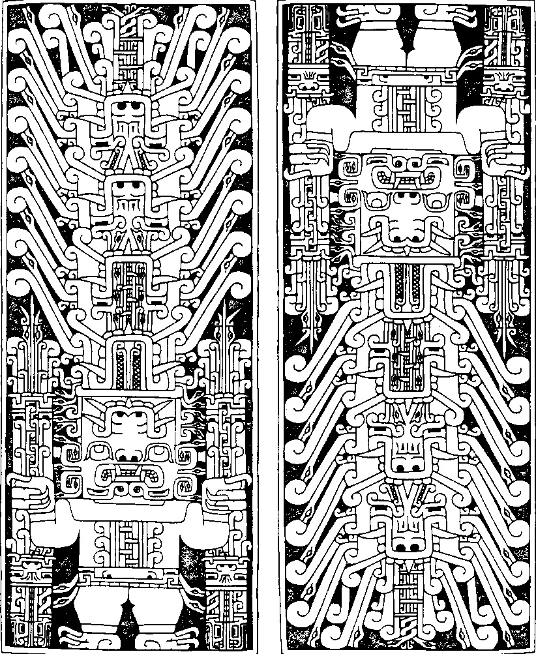
3.4.2c Drawing of detail from the Raimondi Stela

Slide 9
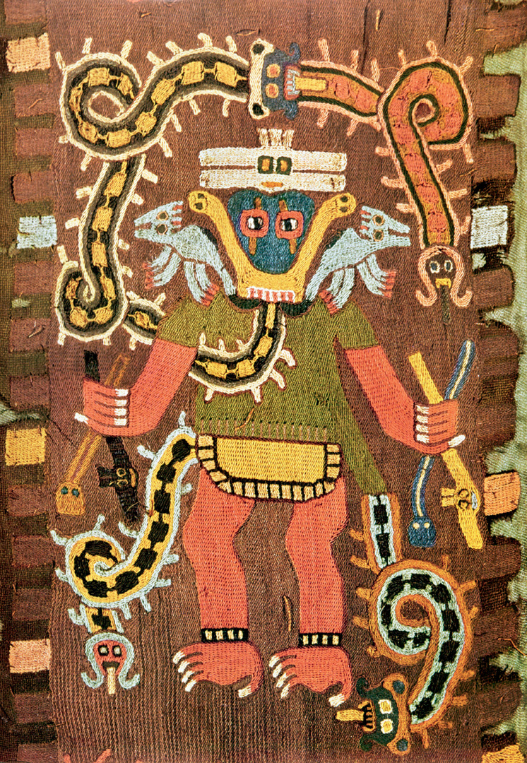
Paracas textile embroidered with mythological figure
Andean textiles show a continuation of style and content from Chavín culture
Well preserved due to dry conditions
Mantle: garment for burial purposes

Slide 10
3.4.3 Paracas textile, embroidered with mythological figure, 3rd century BCE. Wool embroidery. Museo Arquelogía, Lima, Peru

Slide 11
The Nasca
Geoglyphs were created by the Nasca people, whose culture which flourished in Peru sometime between 1-700 C.E.
They inhabited the river valleys of the Rio Grande de Nasca and the Ica Valley in the southern region of Peru, where they were able to farm, despite the desert environment—one of the driest regions in the world

Slide 12
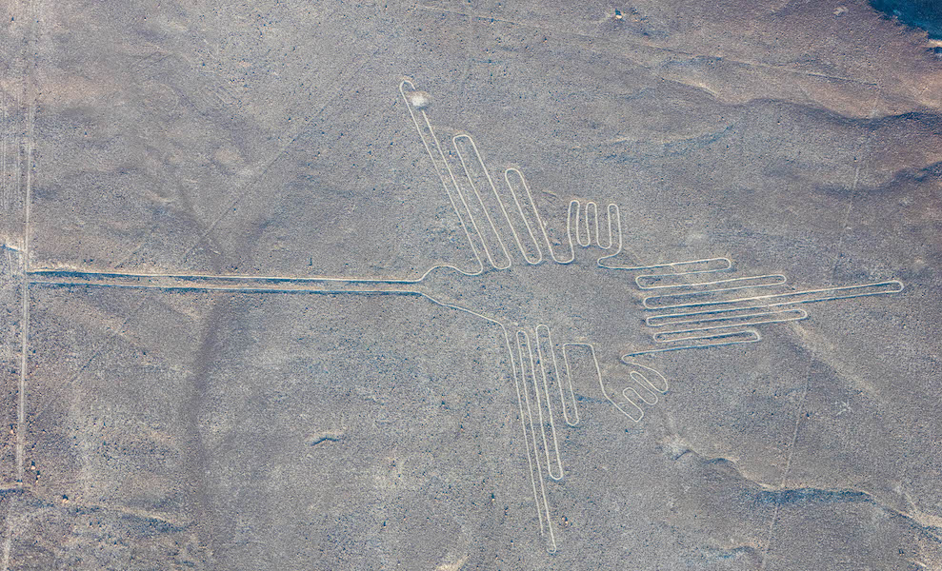
Hummingbird, Nasca Geoglyph, Peru, over 300 feet in length, formed approximately 2000 years ago

Slide 13
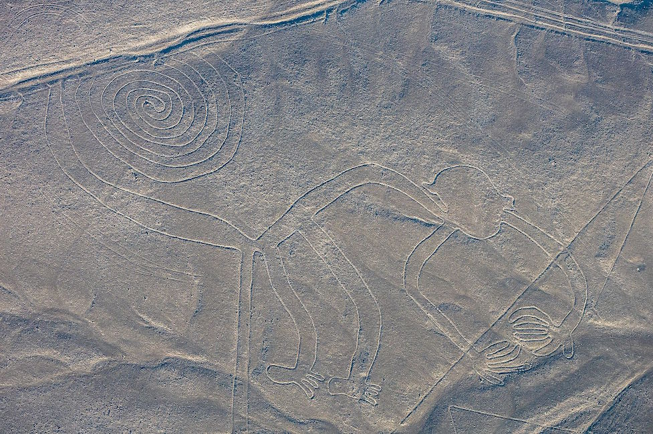
Monkey with Spiral Tail, Nasca Geoglyph, approximately 2000 years old

Slide 14
The Moche
Northern Peru
About 200 bce to 600 ce
Known for pottery, textiles, and metalwork

Slide 15
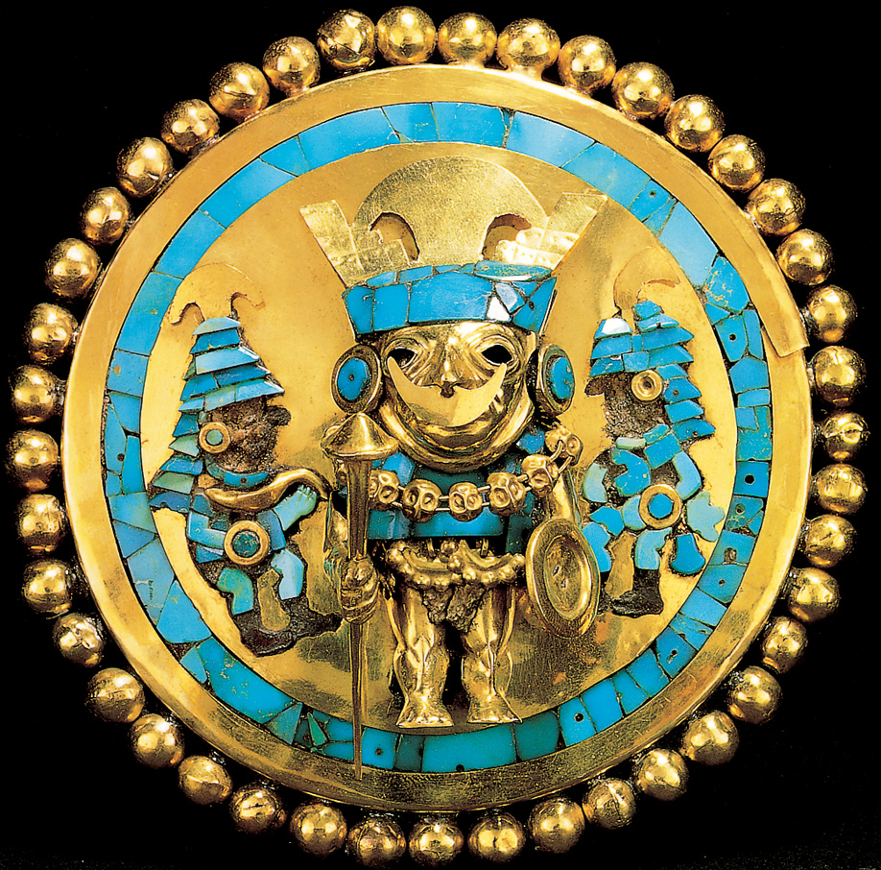
3.4.4 Earspool, c. 300 CE. Gold, turquoise, quartz, and shell, diameter 5”. Royal Tombs of Sipán Museum, Sipán, Peru

Slide 16
The Inca
Existed as a culture as early as 800 ce
Established by powerful Inca ruler, Pachacuti
Became the largest empire in pre-Columbian America (controlled more than 3,000 miles on the western coast of South America.

Slide 17
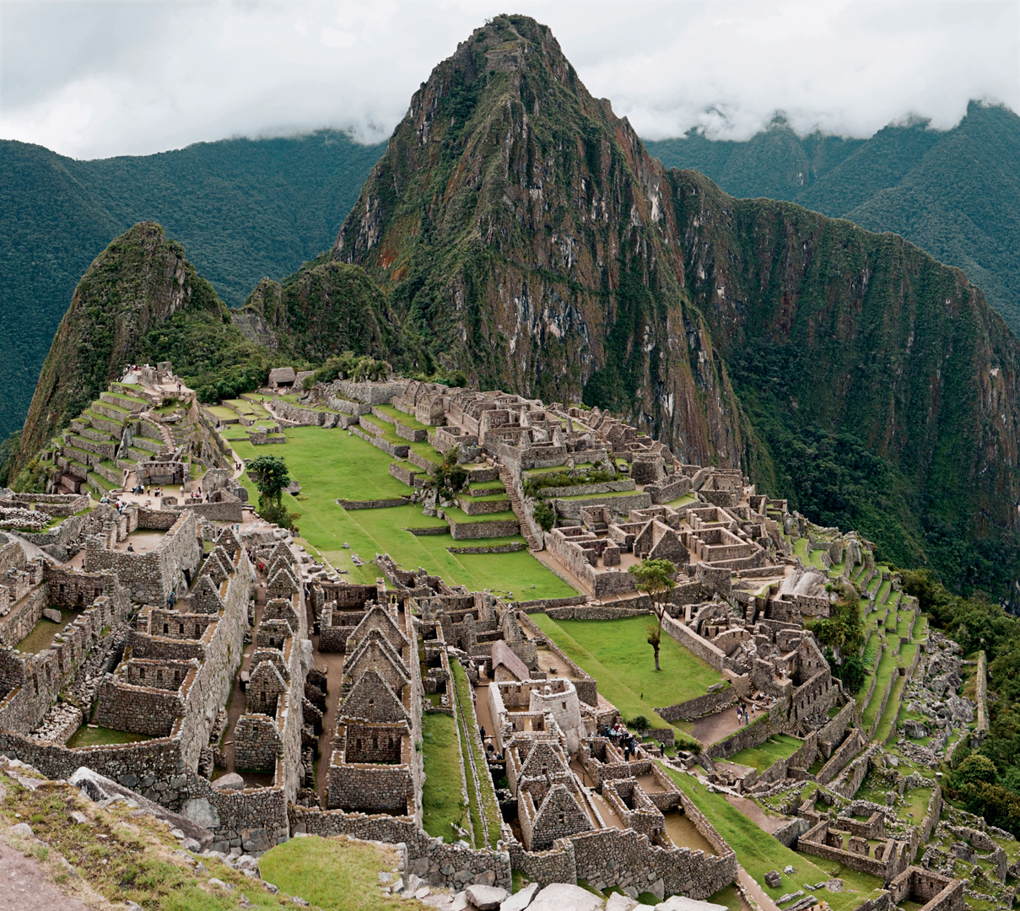
Machu Picchu, Peru
Pachacuti’s private estate and religious retreat
The condor is depicted throughout
Mortarless stonework
Abandoned c. 1527; excavated 1911

Slide 18
3.4.5 Machu Picchu, 1450–1530, Peru

Slide 19
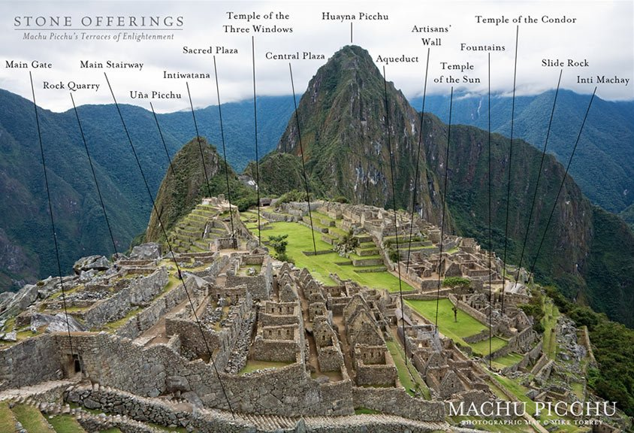

Slide 20
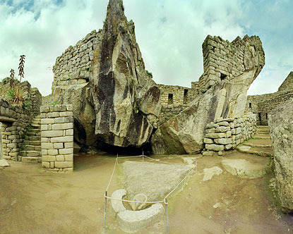
Temple of the Condor, Machu Picchu.

Slide 21
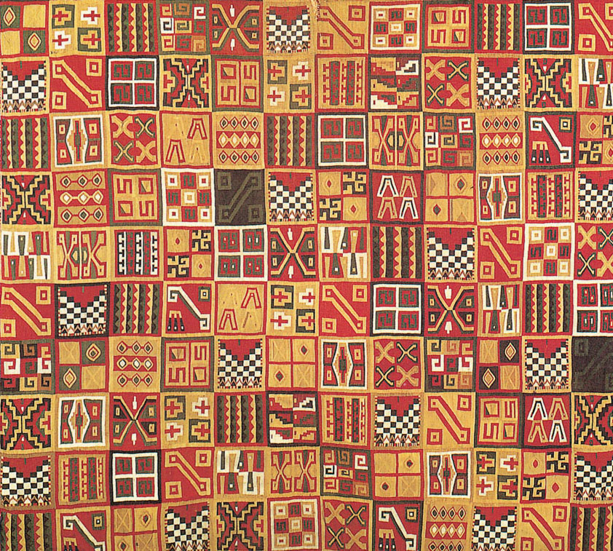
3.4.6 Tunic, c. 1500. Interlocked tapestry of cotton and wool, 35 ⅞ × 30⅛". Dumbarton Oaks Research Library and Collections, Washington, D.C. Andean textiles made by women; weaving was a sacred art with its own god, Spider Woman.

Slide 22
Mesoamerica
Area of modern-day Mexico and Central America (Honduras, Belize, Nicaragua)
Cultures include: Olmecs, Teotihuacanos, Maya, Aztecs
Used images as a form of writing (Maya hieroglyphs, Aztec pictographs)

Slide 23
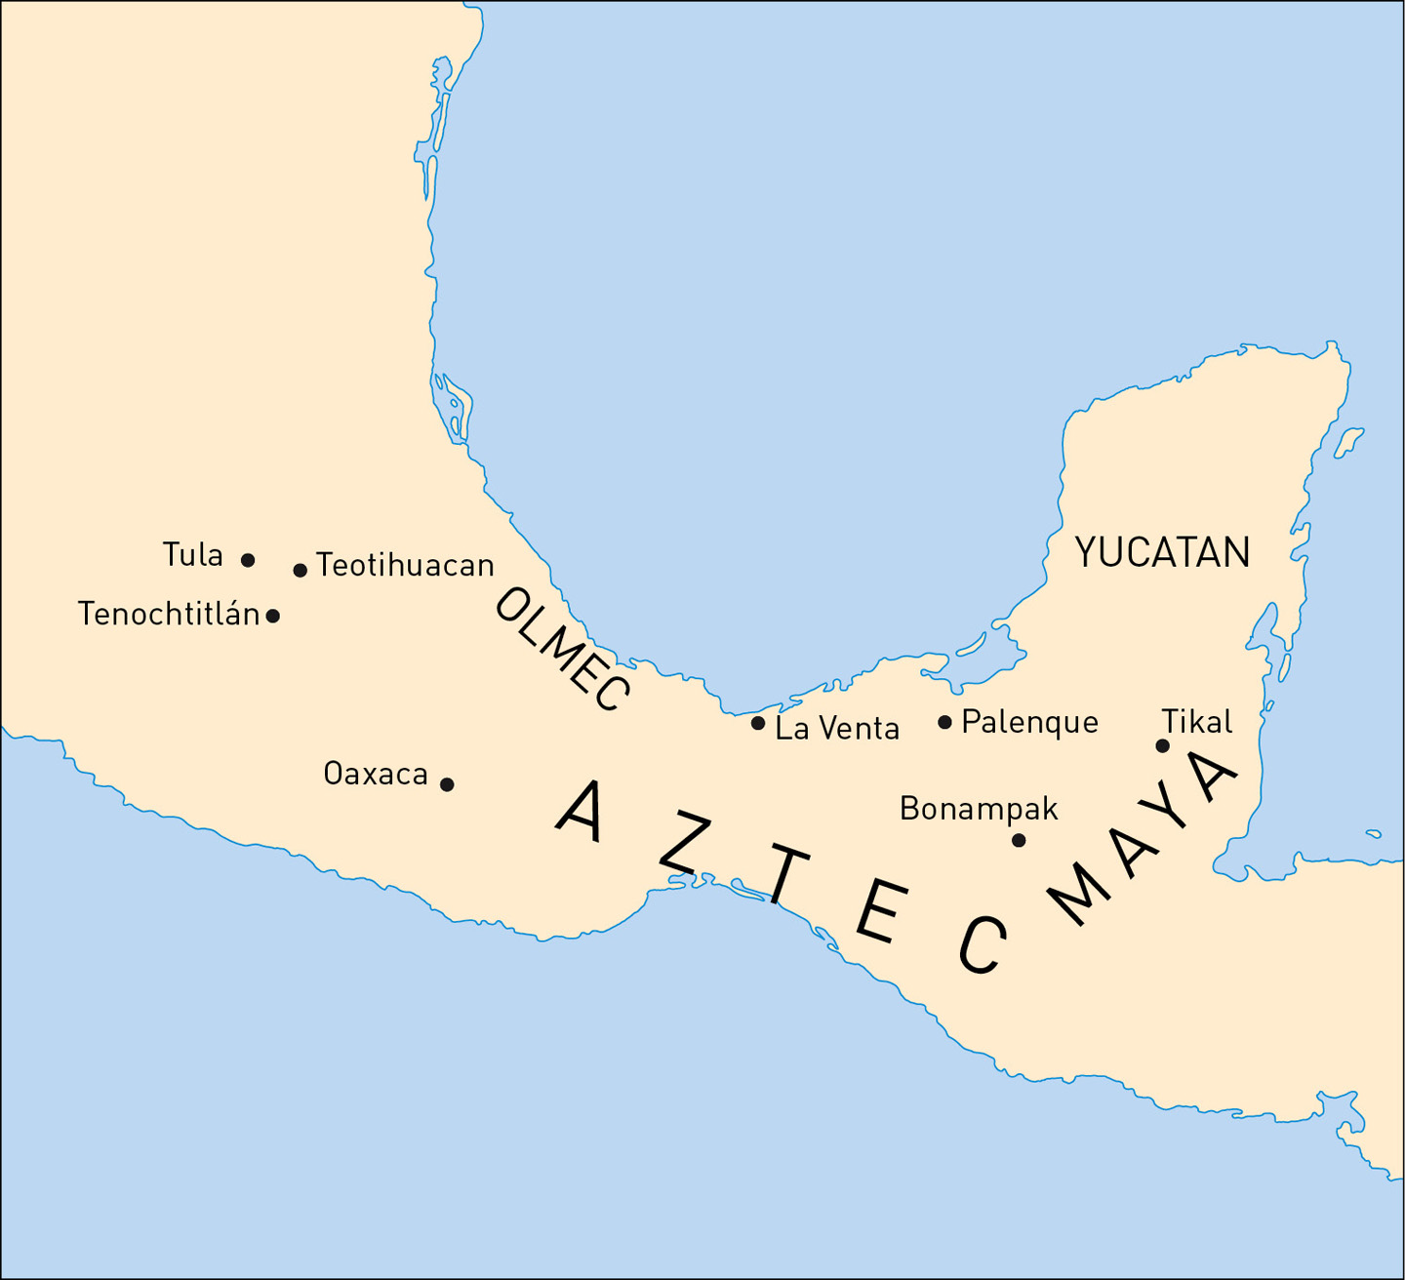
3.4.7 Map of Mesoamerica

Slide 24
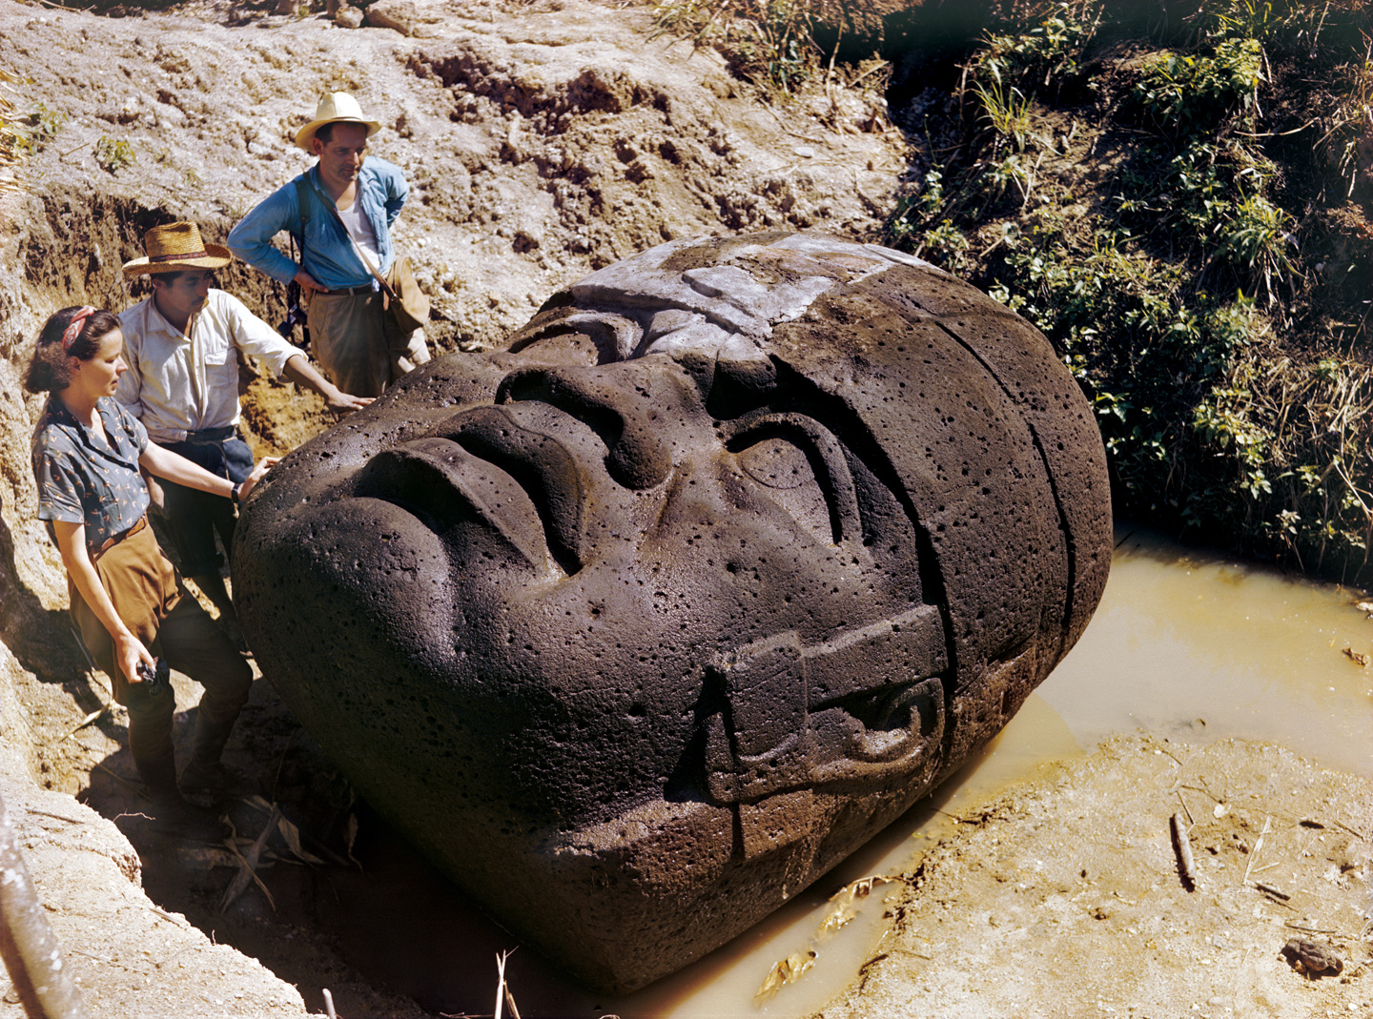
Colossal Olmec Head
Made of basalt, hard volcanic stone boulders transported over 30 mi.
Total of 17 of these heads found
Range from 5 to 12 ft (this one is 8 ft tall)
Weigh approximately 6 to 25 tons
Possibly portraits of rulers

Slide 25
3.4.8 Olmec Colossal Head, San Lorenzo, state of Veracruz, Mexico. Uncovered by Matthew and Marion Stirling in 1945

Slide 26
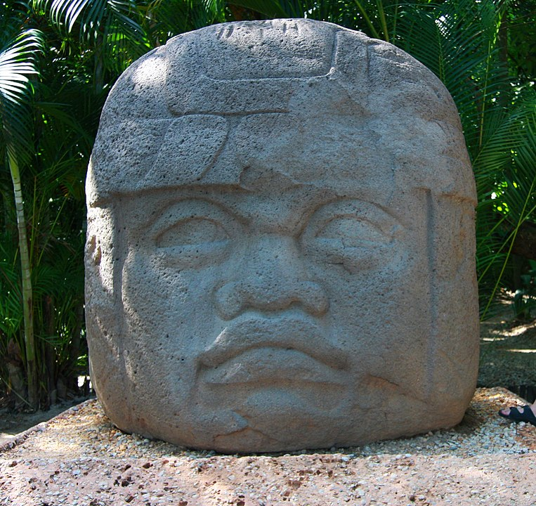
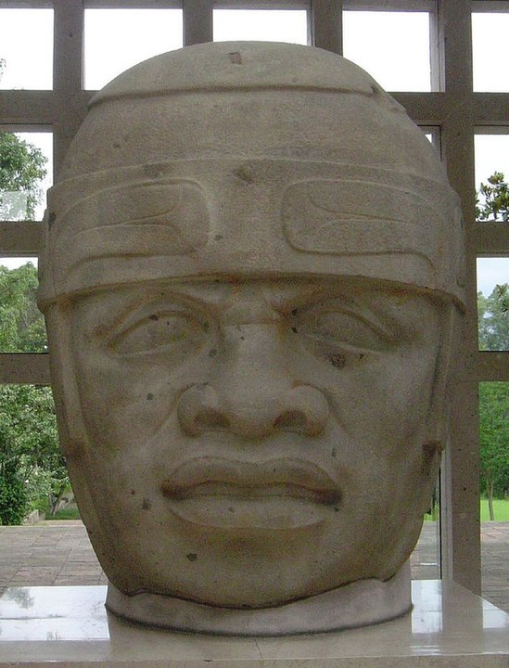

Slide 27
Teotihuacan
Site located in the Central Highlands of Mexico (near modern-day Mexico City)
Peaked around 500 ce: 600 pyramids and 2,000 apartment compounds
Pyramid and plaza configuration

Slide 28
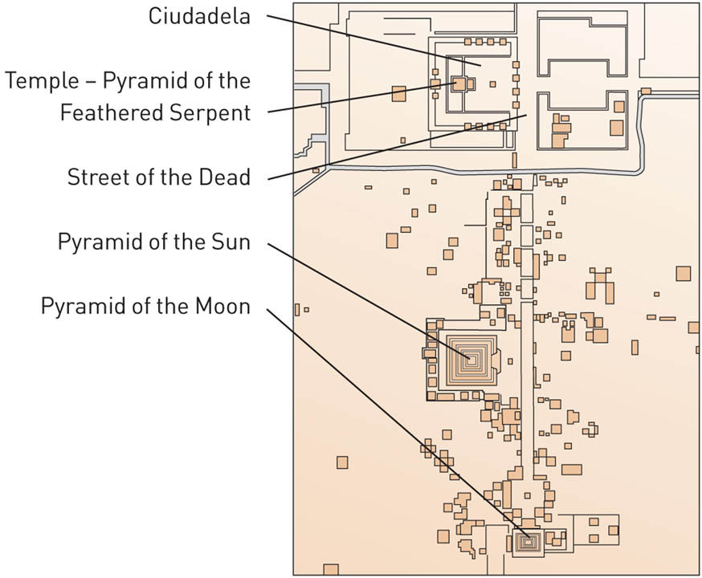
3.4.9a Plan of the ceremonial center, Teotihuacan, Mexico

Slide 29
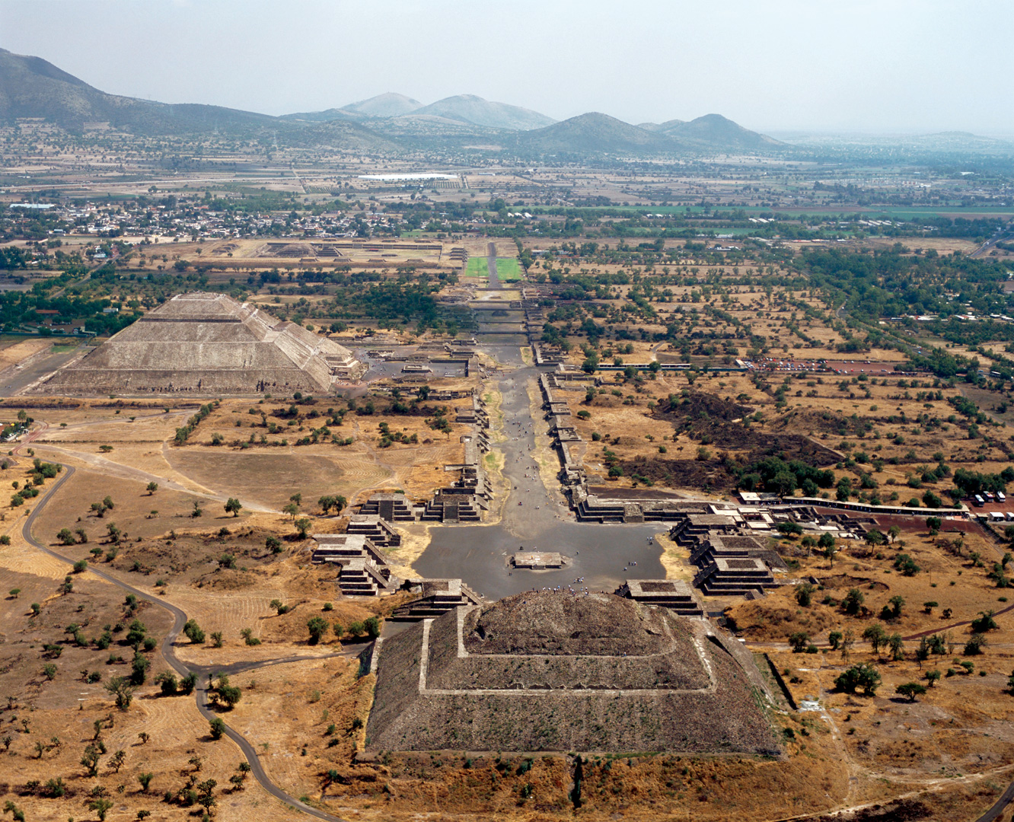
3.4.9b Aerial view (from Pyramid of the Moon) of the ceremonial center, Teotihuacan, Mexico

Slide 30
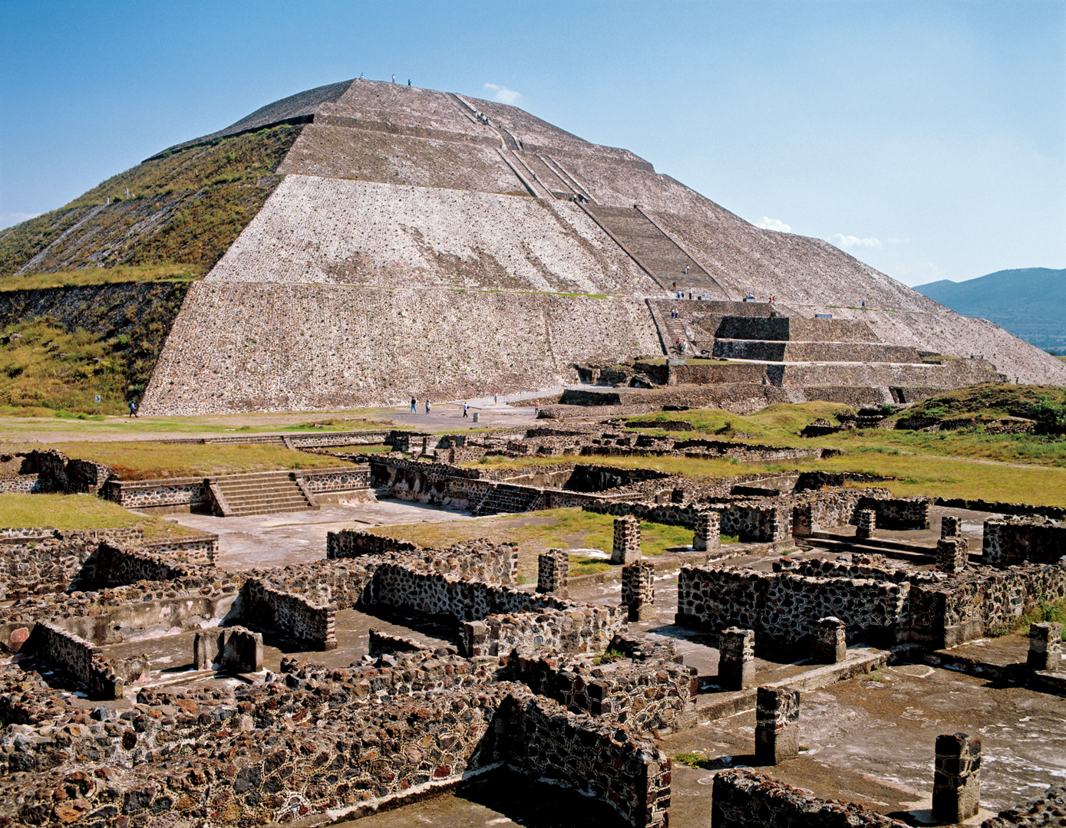
Pyramid of the Sun, Teotihuacan, Mexico
Largest structure on the site: stepped pyramid, 700 ft across on each side; 210 ft tall
Importance of location
Admired by the Aztecs, 800 years after Teotihuacan was abandoned
Became a place of Aztec pilgrimage

Slide 31
3.4.10 Pyramid of the Sun, c. 225 CE, Teotihuacan, Mexico

Slide 32
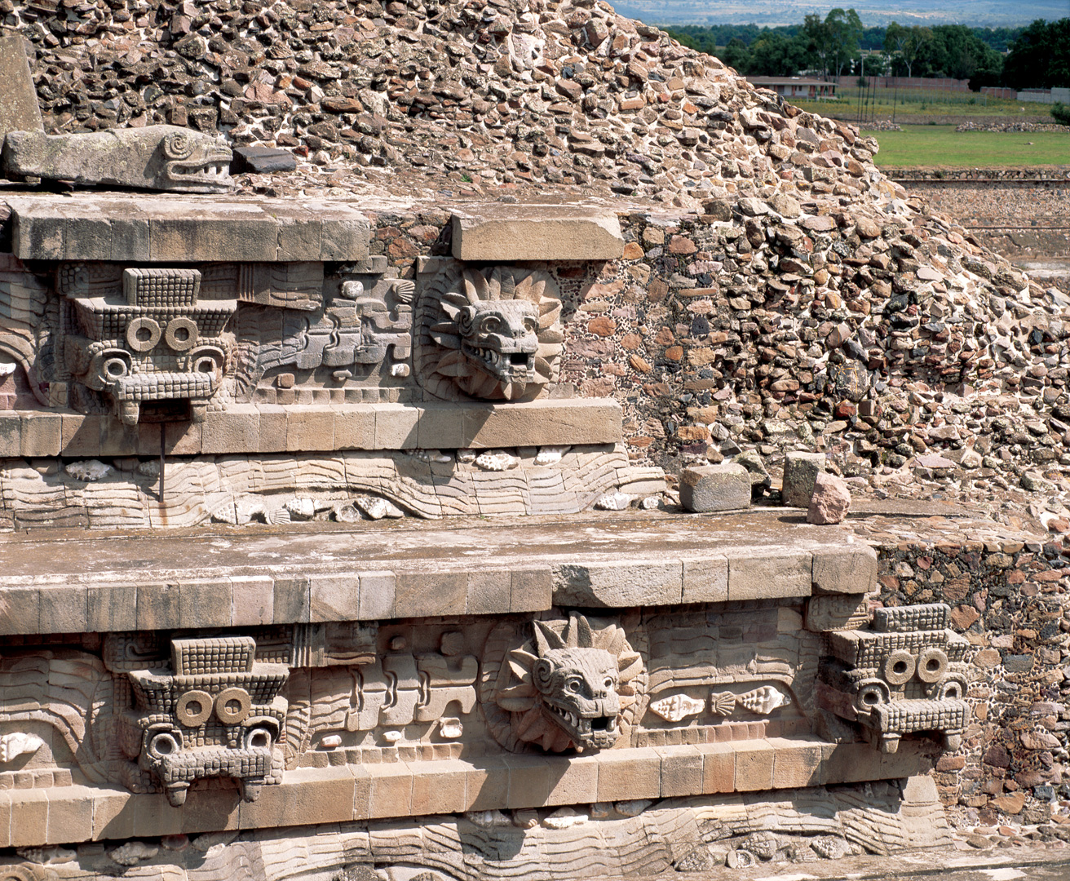
Temple of Quetzalcoatl at Teotihuacan
Located in an enclosed compound
Sculpted heads symbolize warfare and fertility, or cycles of wet/dry seasons
Gods Quetzalcoatl (feathered serpent) and Tlaloc (goggle-eyed rain god) are depicted

Slide 33
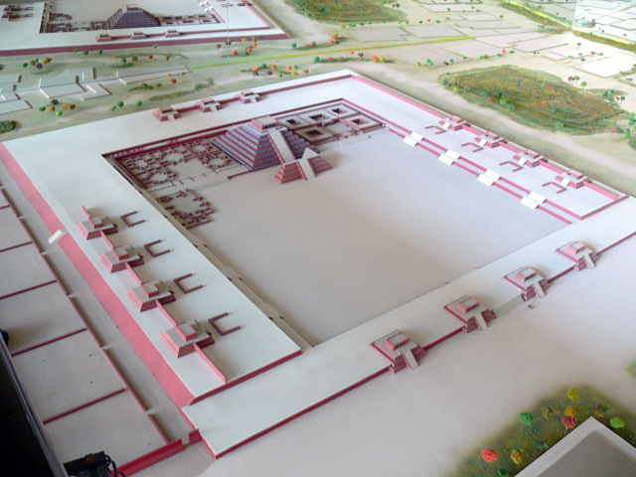

Slide 34
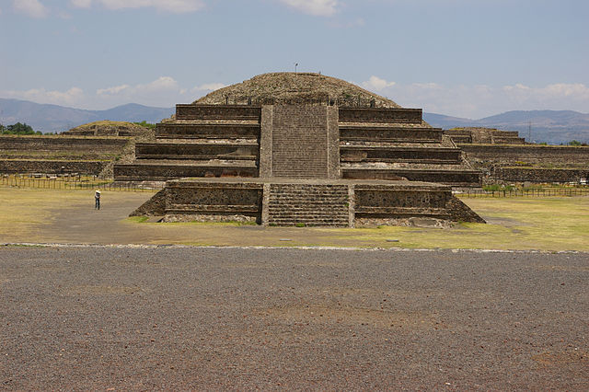

Slide 35
3.4.12 Architectural sculpture with serpent heads and masks on the Temple of Quetzalcoatl at Teotihuacan, Mexico (also known as the Temple of the Feathered Serpent)

Slide 36
The Maya
Cultural group with city-states throughout Mesoamerica
From about 2000 bce–1500 ce (peak 300–900 ce)
Estimated 7 million Maya living today
Importance of mythology and cosmology and associated rituals

Slide 37
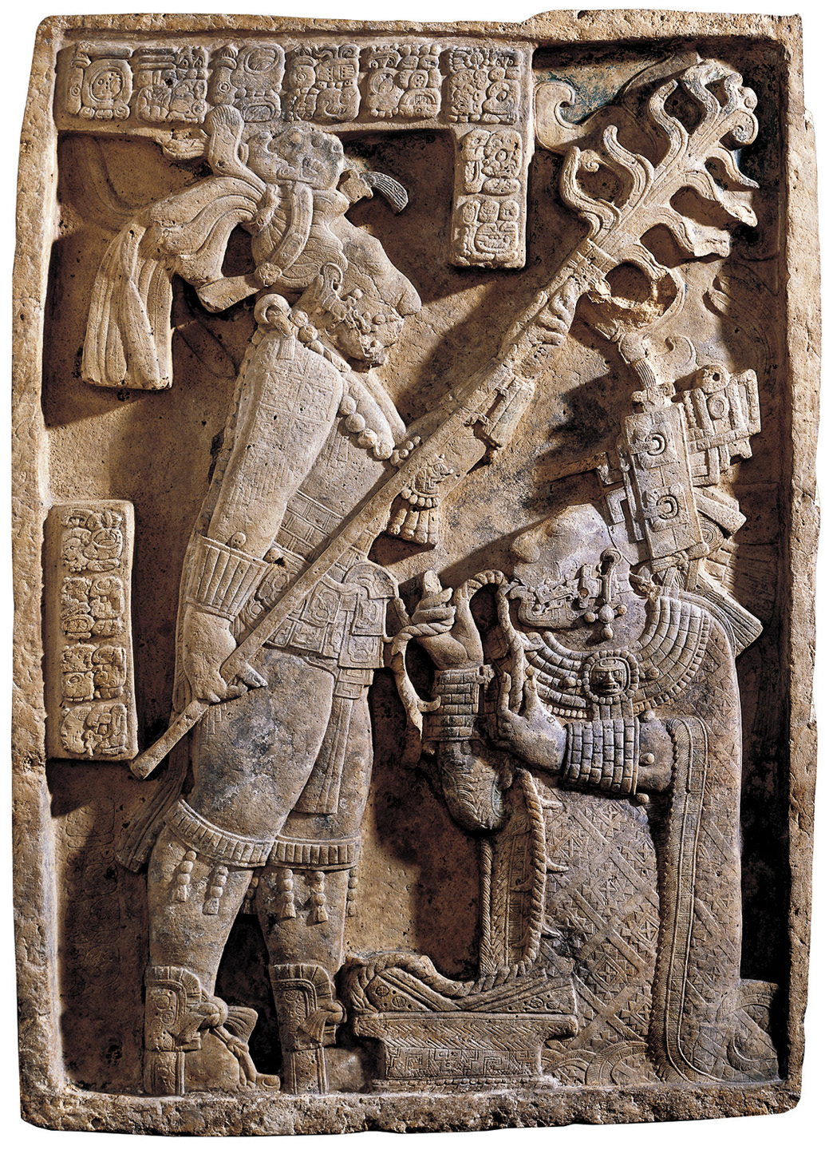
3.4.11a Maya Lintel 24
showing Shield Jaguar
and Lady Xoc, c. 725 CE.Limestone, 43 × 30 ¾ × 2 ⅜". British Museum, London, England
Lintel 24: Lady Xoc is pulling a thorny rope through her tongue by torch light. Bloodletting ritual was necessary to win the favor the gods for important events. Event: birth of Bird Jaguar III in 709 CE

Slide 38
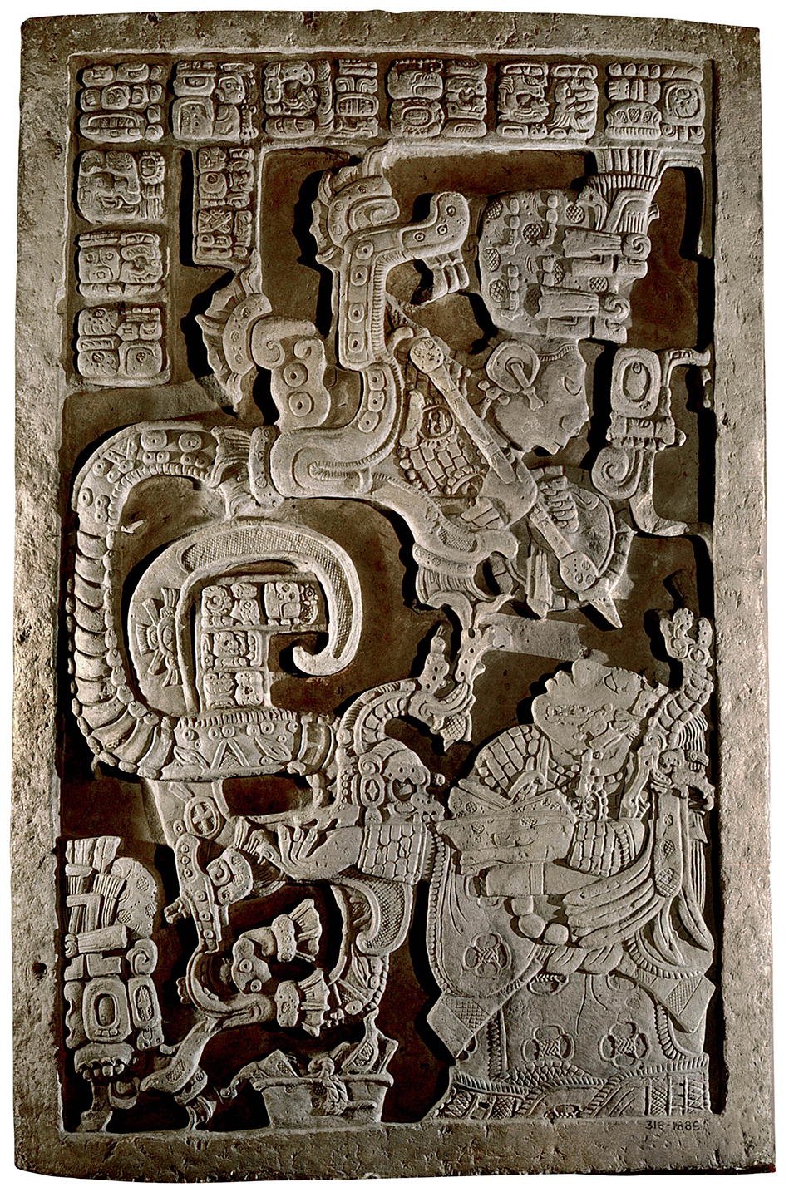
3.4.11b Maya
Lintel 25. Limestone,
47 ⅝ × 33 ¾ × 5 ⅜".
British Museum,
London, England
Lintel 25: vision serpent arising from bowl of burning, blood-soaked paper. Bloodletting induced hallucinatory state=visions.
Shield Jaguar’s ascension to throne in 681 CE.

Slide 39
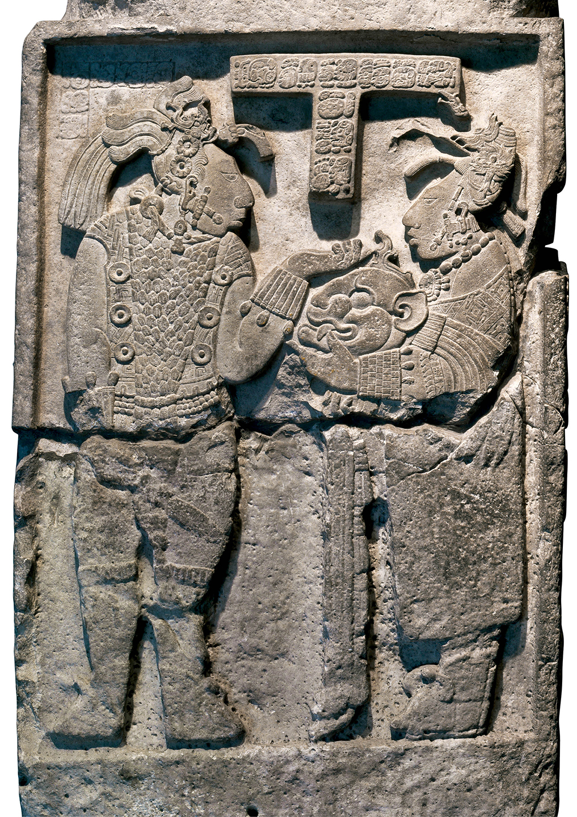
3.4.11c Maya
Lintel 26. Limestone,
72 ½ × 33 ⅞ × 10 ⅝".
British Museum,
London, England
Lintel 26: Lady Xoc handing her husband a jaguar helmet and shield in preparation for battle.

Slide 40
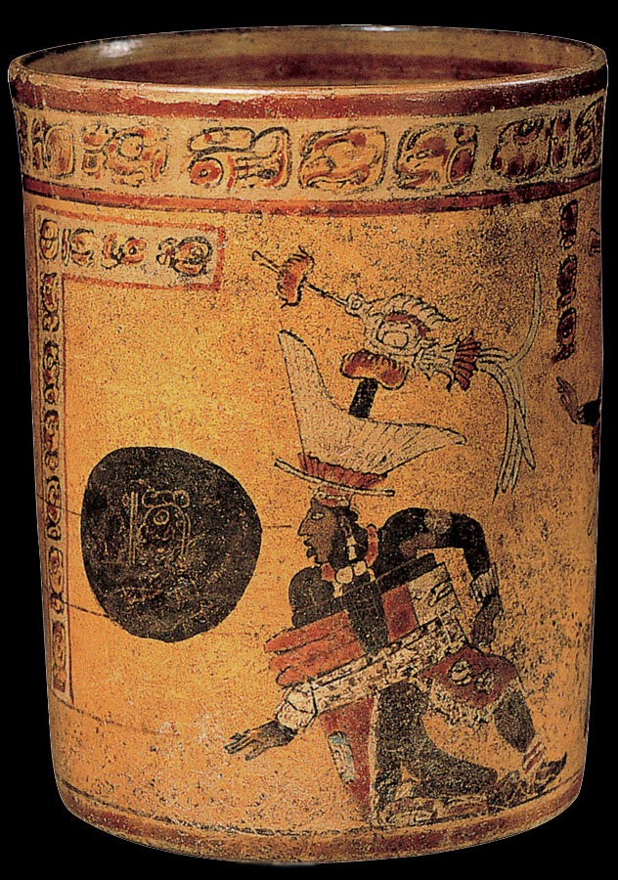
3.4.13 Cylindrical vessel with ritual ballgame scene, c. 700–850. Ceramic, 6¼ × 4”. Dallas Museum of Art, Texas. Chunkey: ritual, sport, gambling, gladiator.

Slide 41
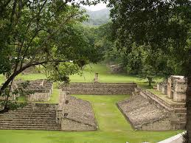
Ball court (looking northeast), Middle Plaza, Copan, Honduras, Maya, 738 CE.

Slide 42
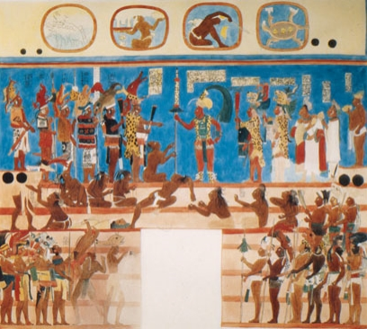
Bonampak Mural
To commemorate the victory of the Lord of Bonampak, Chaan Muan
Gruesome ritual presentation of captives
Maya considered blood on temple steps a sign of triumph and a way to please the gods

Slide 43
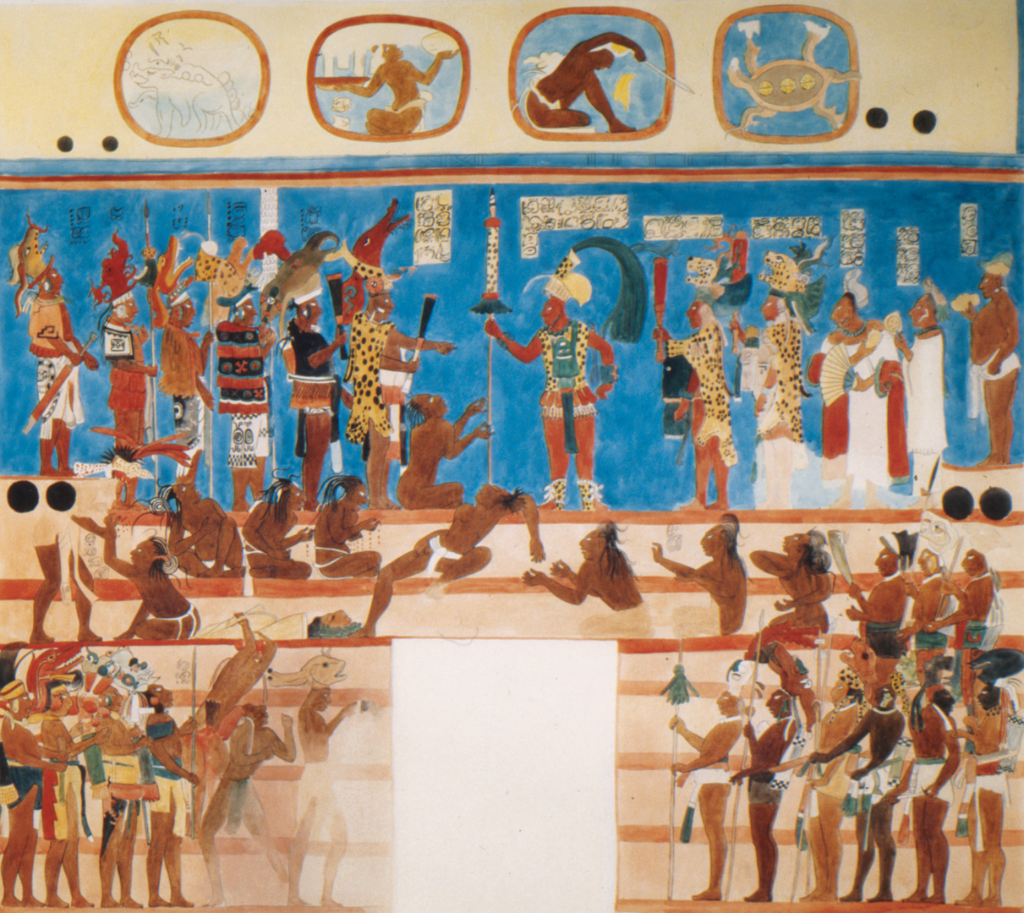
3.4.14 Bonampak mural, Room 2, copy of fresco from Room 2, original 8th century. Peabody Museum, Harvard University, Cambridge, Massachusetts

Slide 44
The Aztecs
Aztecs were the largest Mesoamerican culture at the time that Cortes and his compatriots arrived in Mexico.
They were one of a number of invading groups from the north during period of war between 1200-1300. With amazing speed, the Aztec established rule in the area. Fierce in war and cruel in peace.
They began to call themselves Mexica and fulfilled a legendary prophecy that they would build a city where they saw an eagle perched on a cactus with a serpent in its mouth. They built their capital city Tenochtitlan (=Mexico City). The ruins of the city lie directly below Mexico City’s main square, the Zocalo.
Practiced bloodletting and human sacrifice to please the gods and sustain the great cycles of the universe. “Flowery wars”

Slide 45
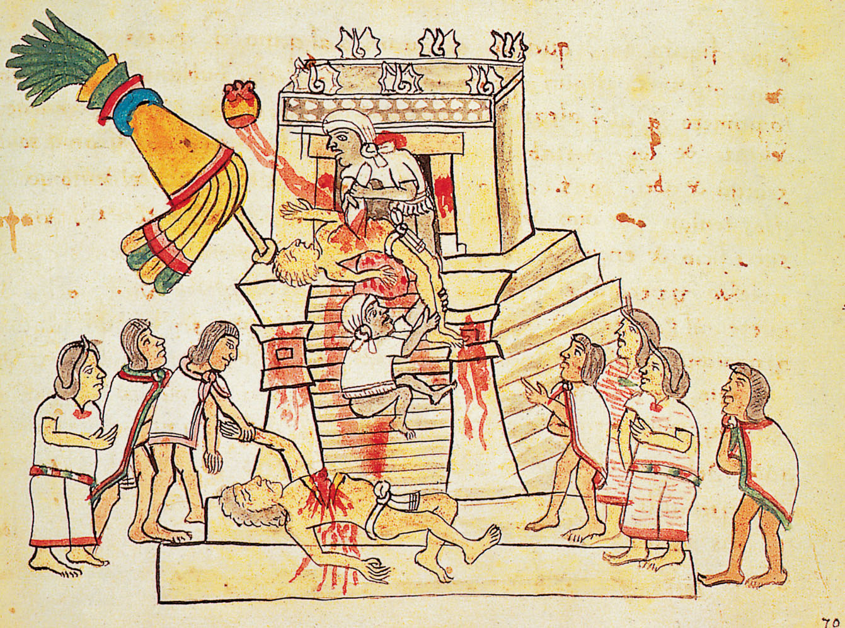
A human sacrifice
Ritual sacrifice at the top of the pyramid
Notorious Aztec practice of extracting the victim’s still-beating heart
Sacrificial victims were captured in warfare, but could also be members of the Aztec community

Slide 46
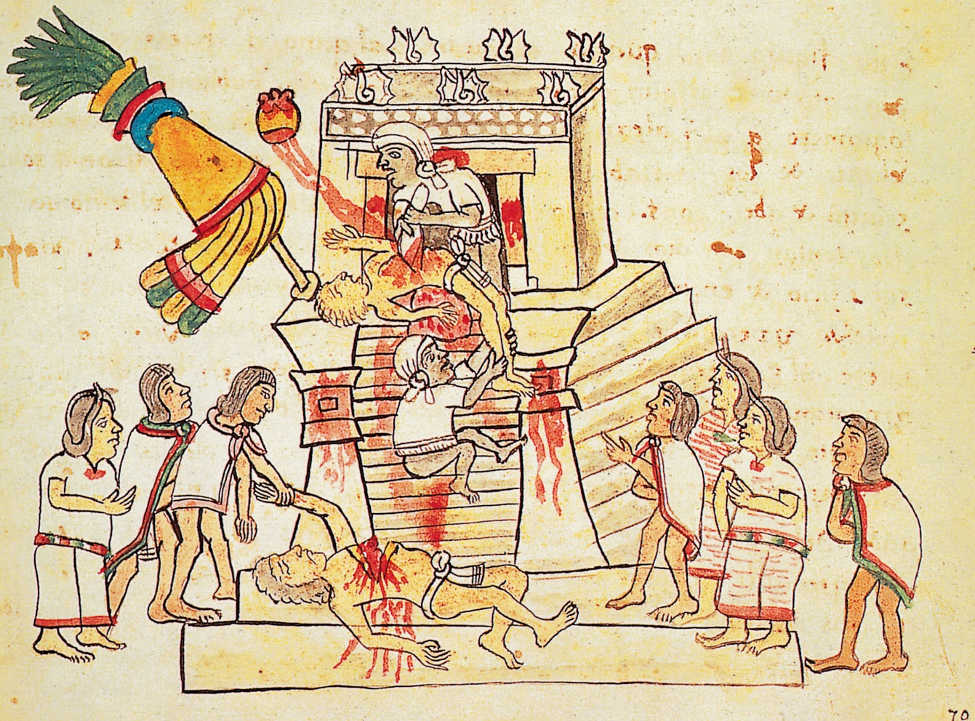
3.4.15 A human sacrifice, fol. 70r of the Codex Magliabechiano, 16th century. European paper, 6½ × 8⅞”. Biblioteca Nazionale Centrale, Florence, Italy

Slide 47
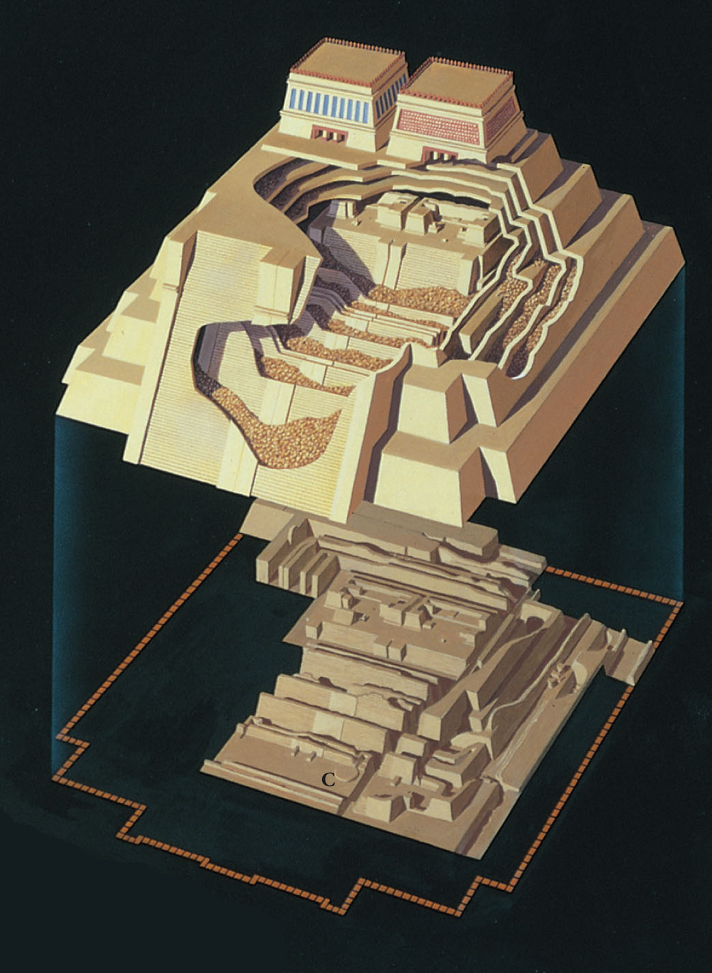
Reconstruction drawing with cutaway view of various rebuildings of the Great Temple (Hueteocalli), Aztec, Tenochtitlan, Mexico City, Mexico, ca. 1400-1500. C = Coyolxauhqui disk Temple built in honor of the Aztec gods Huitzilopochli (hummingbird god of war) and Tlaloc (rain god). Superimposition: incorporation of earlier buildings within the later ones.

Slide 48
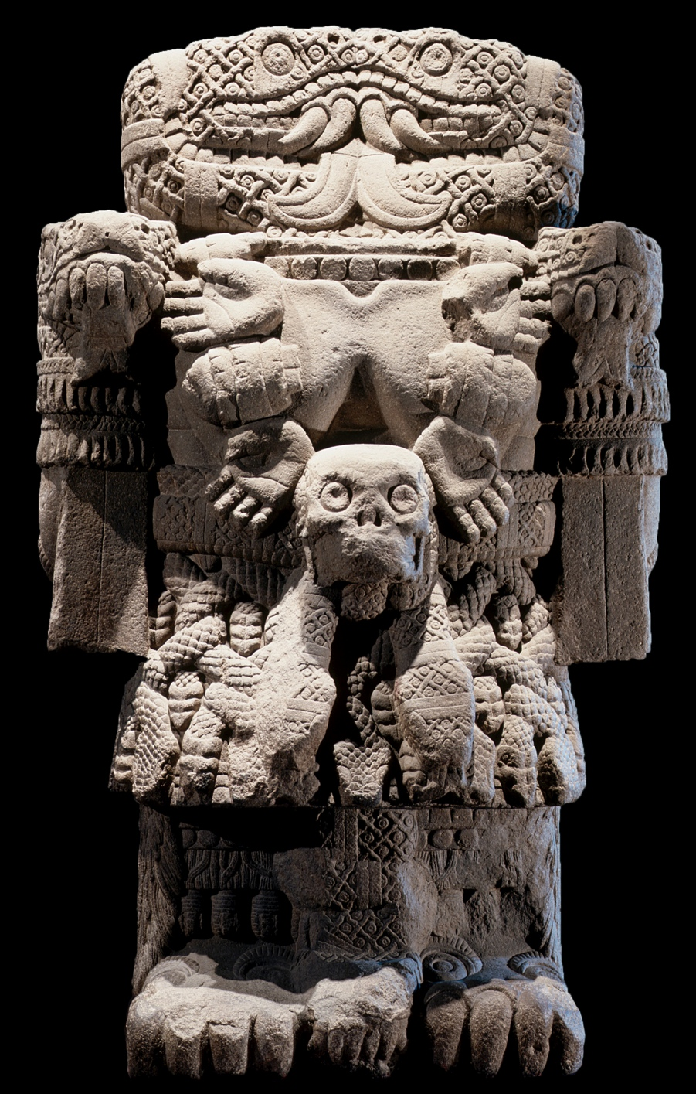
Coatlicue, Aztec, from Tenochtitlán, Mexico City, Mexico, ca. 1487–1520. Andesite, 11’ 6” high. Museo Nacional de Antropología, Mexico City. Mother of the gods combines savagery and tenderness. Out of destruction arose new life.

Slide 49
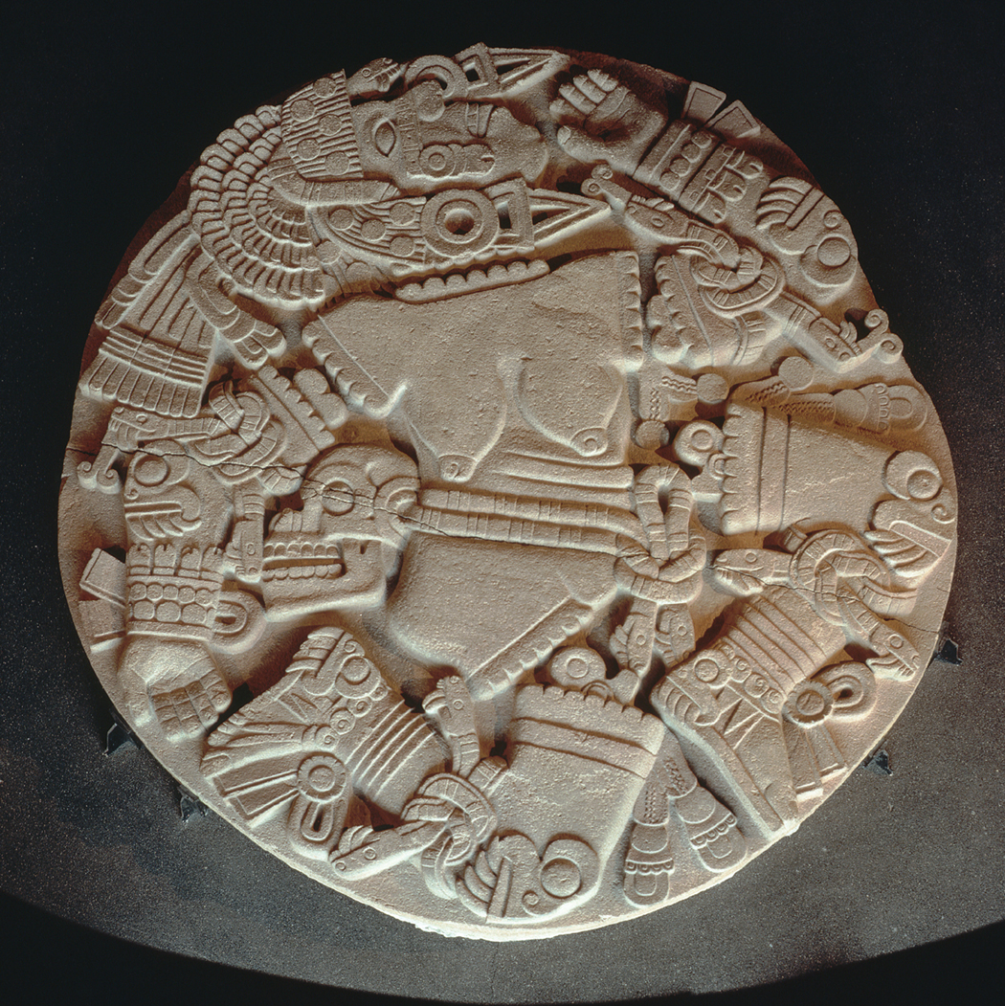
Coyolxauhqui (Moon Goddess), Aztec, from the Great Temple of Tenochtitlán, Mexico City, ca. 1469. Stone, diameter approx. 10’ 10”. Museo del Templo Mayor, Mexico City. Art in the service of state ideology.

Slide 50
North America
Regions of settlement: arctic areas, coast, deserts, plains, wooded forests
Resources were varied
People spoke many different languages and developed diverse cultural traditions

Slide 51
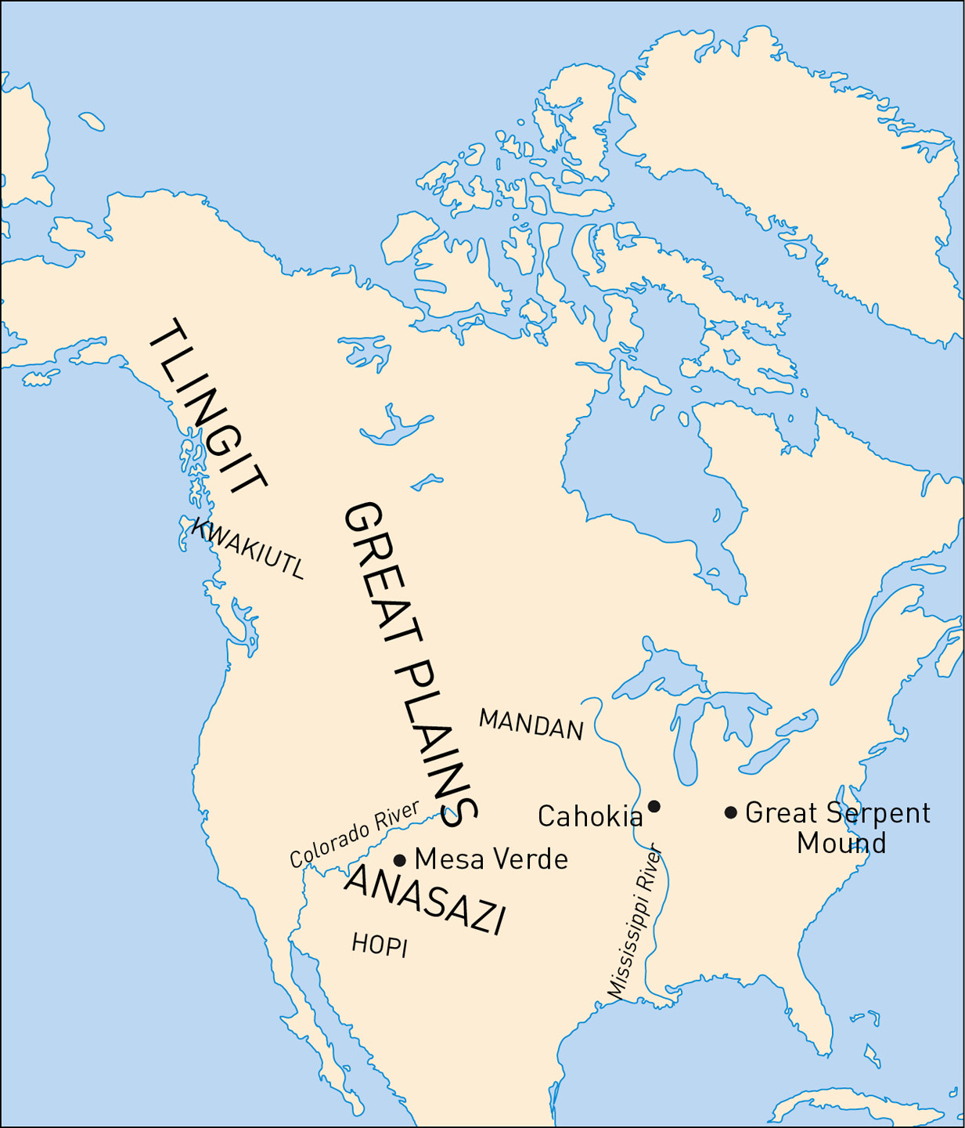
3.4.19 Map of North America

Slide 52
Ancient Puebloans (Anasazi)
People of North America used local materials to build practical structures
Ancient Puebloans moved north c. 1150 from New Mexico to Colorado
Abandoned their later home sometime between 1300 and 1540
Full story is still unknown

Slide 53
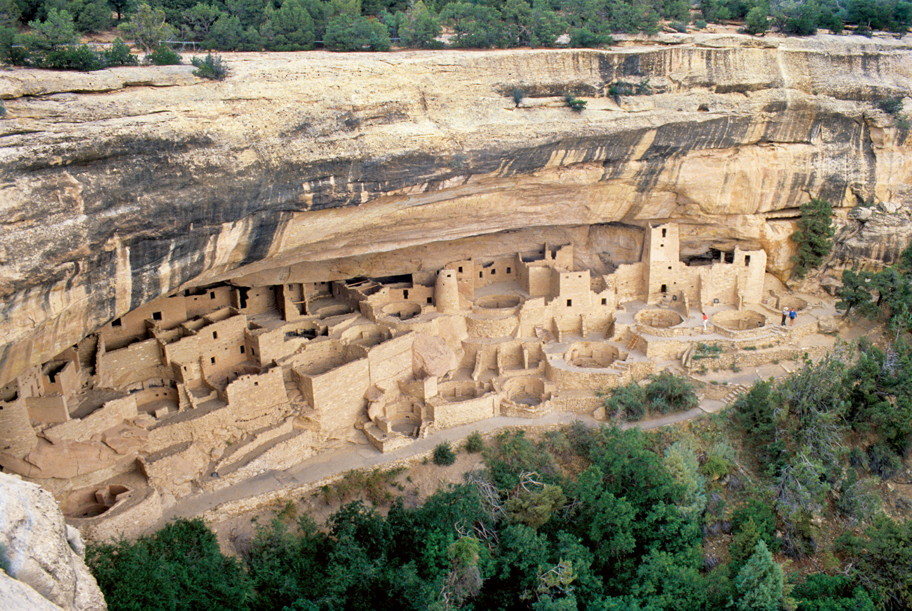
Cliff Palace, Mesa Verde
Communal dwellings of stone, timber, and adobe brick
Built in the ridges high on cliff faces
Often hundreds of feet above the canyon floor
Took advantage of the sun’s orientation for heat and shade

Slide 54
3.4.20 Cliff Palace, 1100–1300, Mesa Verde, Colorado. Comprised of 150 rooms and 23 kivas with an estimated population of about 100.

Slide 55
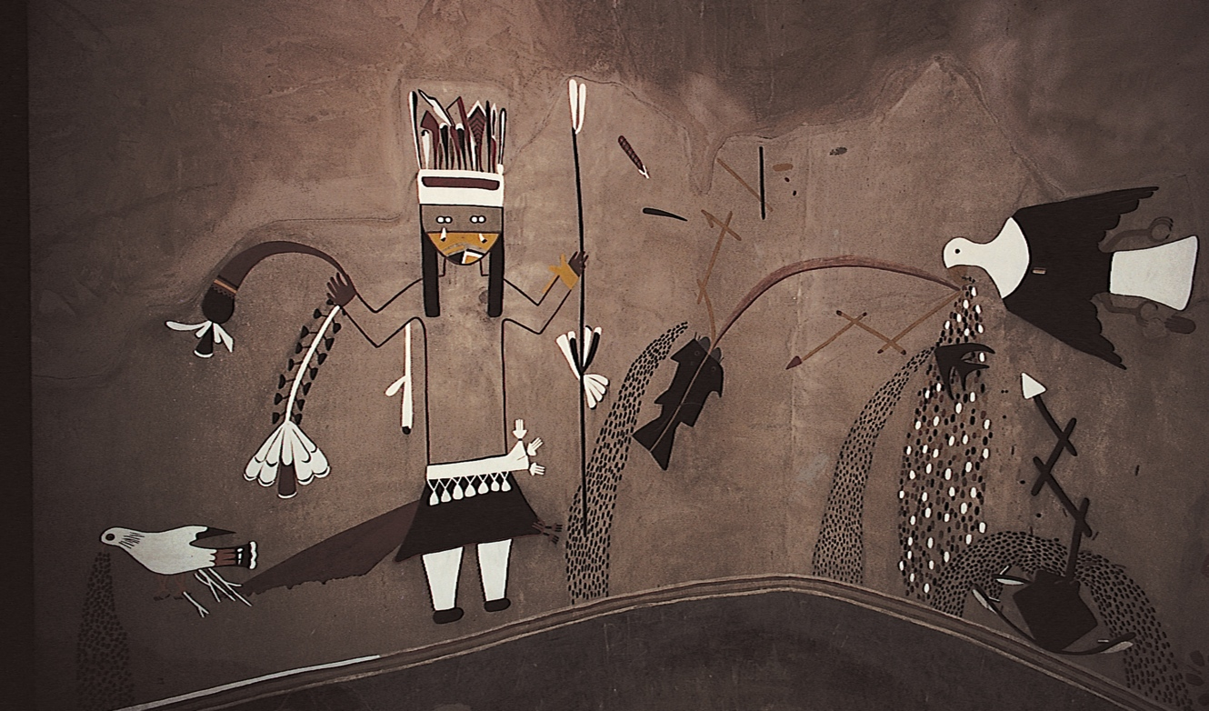
Detail of a kiva mural from Kuaua Pueblo (Coronado State Monument), Ancestral Puebloan, New Mexico, late 15th to early 16th century. Interior ofthe kiva, 18’ X 18’. Museum of New Mexico, Santa Fe.

Slide 56
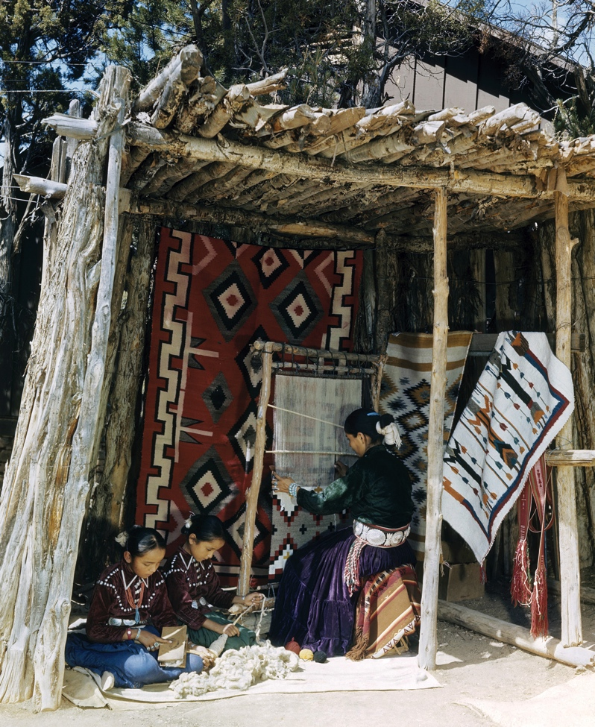
Photograph taken on January 9, 1948, in Mesa Verde National Park of a Navajo mother weaving a blanket on a loom while her daughters assist her by preparing wool for the loom.

Slide 57
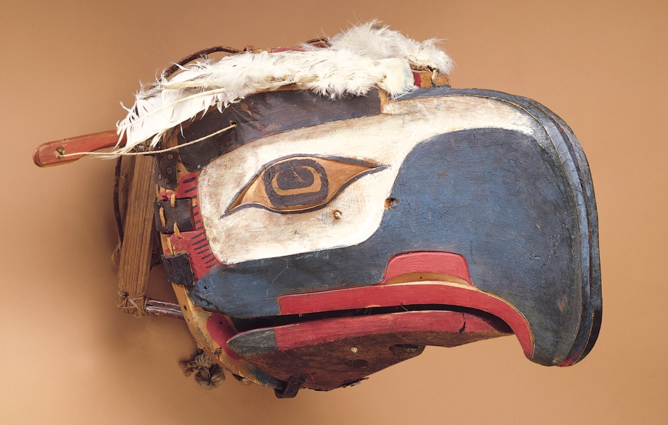
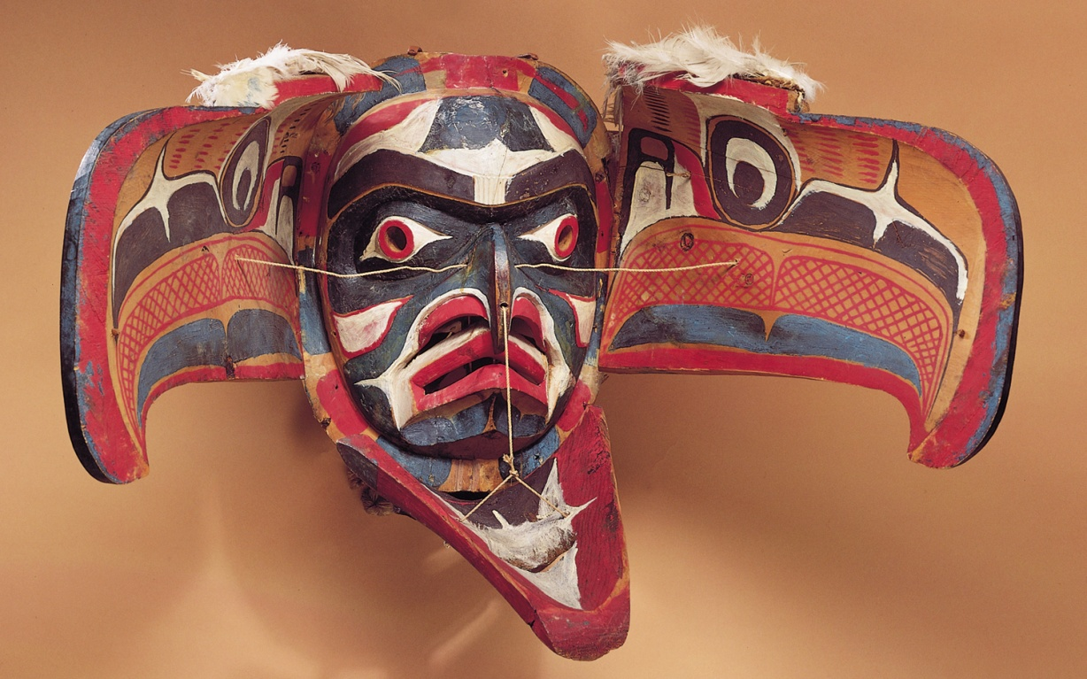
Eagle transformation mask, closed (top) and open (bottom) views, Kwakiutl, Alert Bay, Canada, late 19th century. Wood, feathers, and string, 1’10” X 11”. American Museum of Natural History, New York.

Slide 58
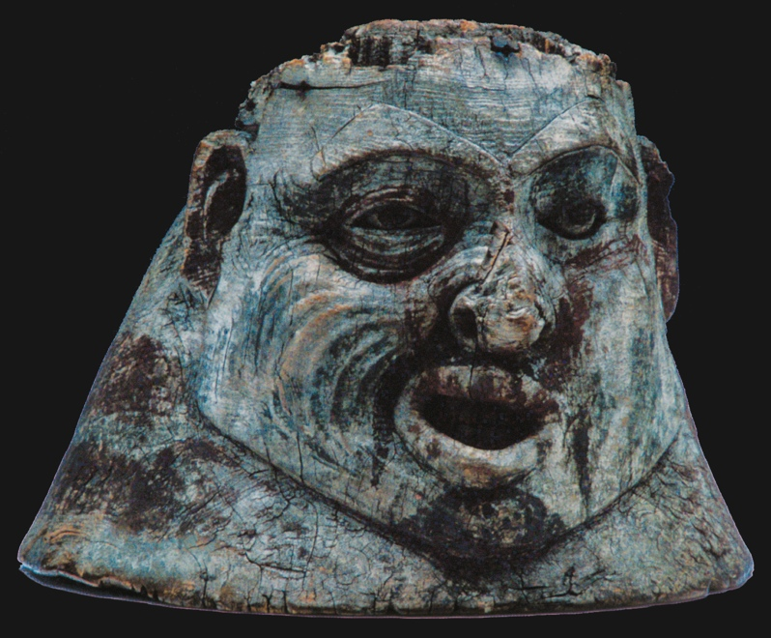
War helmet, Tlingit, Canada, collected 1888–1893. Wood, 1’ high. American Museum of Natural History, New York.

Slide 59
Plains Indians
Occupied the Great Plains of the present-day US
Nomadic lifestyle (Sioux clan, Lakota and Crow) and permanent villages (Mandan)
Used portable homes called tipis (teepees), made of wooden poles and animal hides

Slide 60
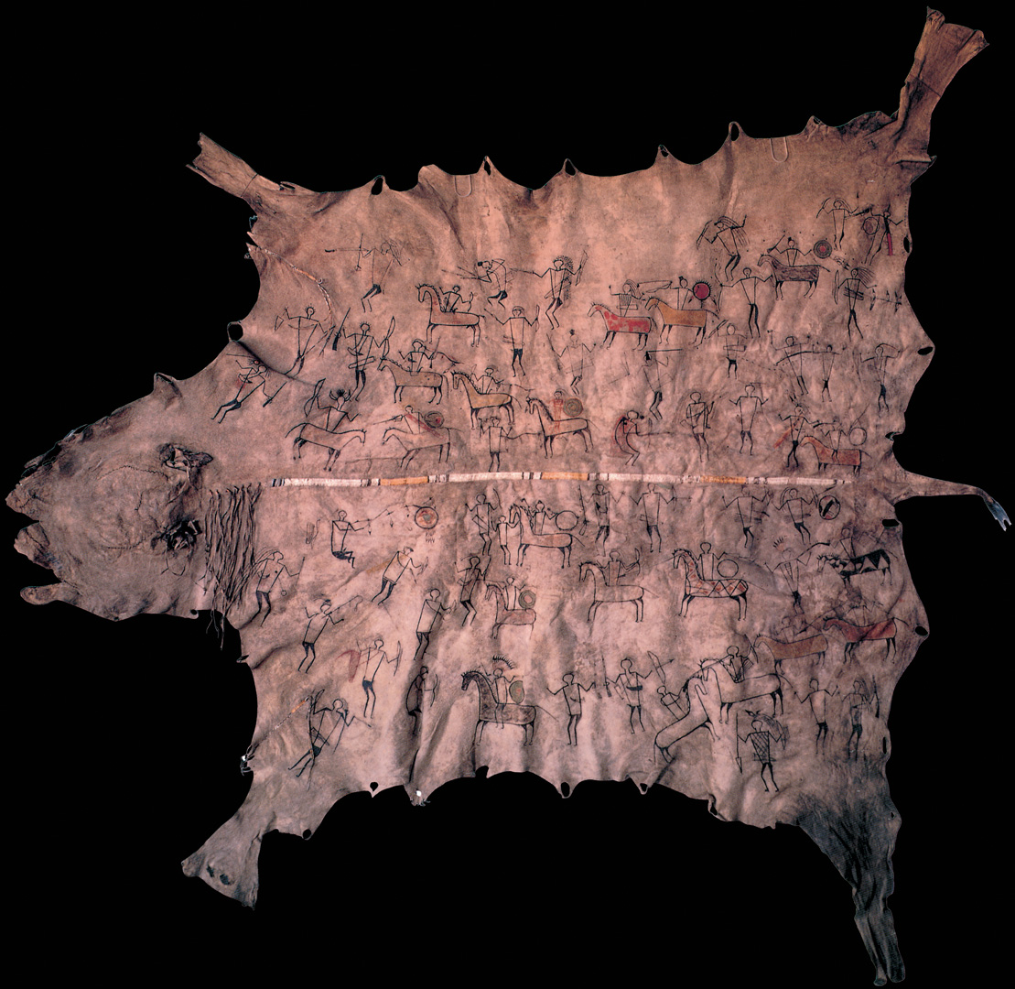
Robe with battle scene
Depicts a battle between the Mandan and Sioux in 1797
Worn over the shoulders of its wearer, a key player in the battle
Robe served a commemorative purpose
Aided in oral story-telling tradition

Slide 61
3.4.21b Robe with battle scene, 1797–1800. Tanned buffalo hide, dyed porcupine quills, and pigments, 37 × 40¼”. Peabody Museum of Archaeology, Harvard University, Cambridge, Massachusetts

Slide 62
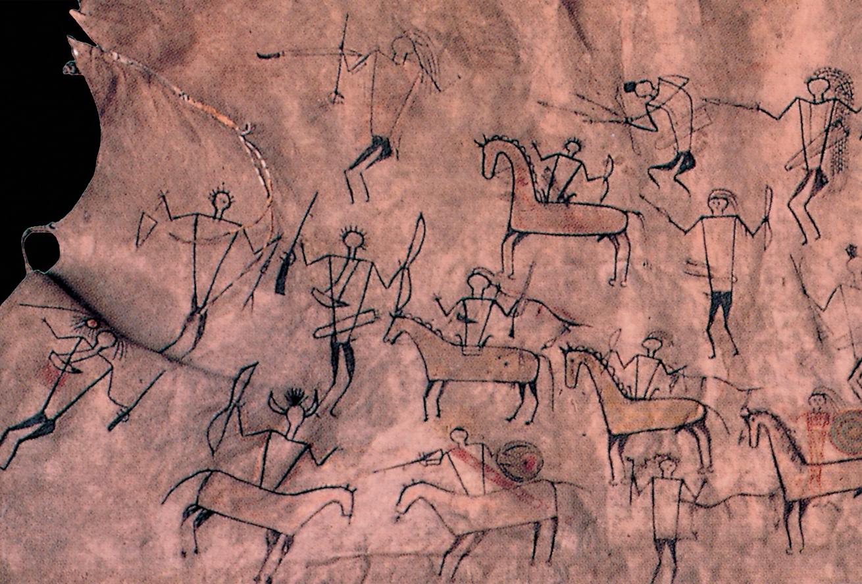
3.4.21a Detail of 3.4.21b

Slide 63
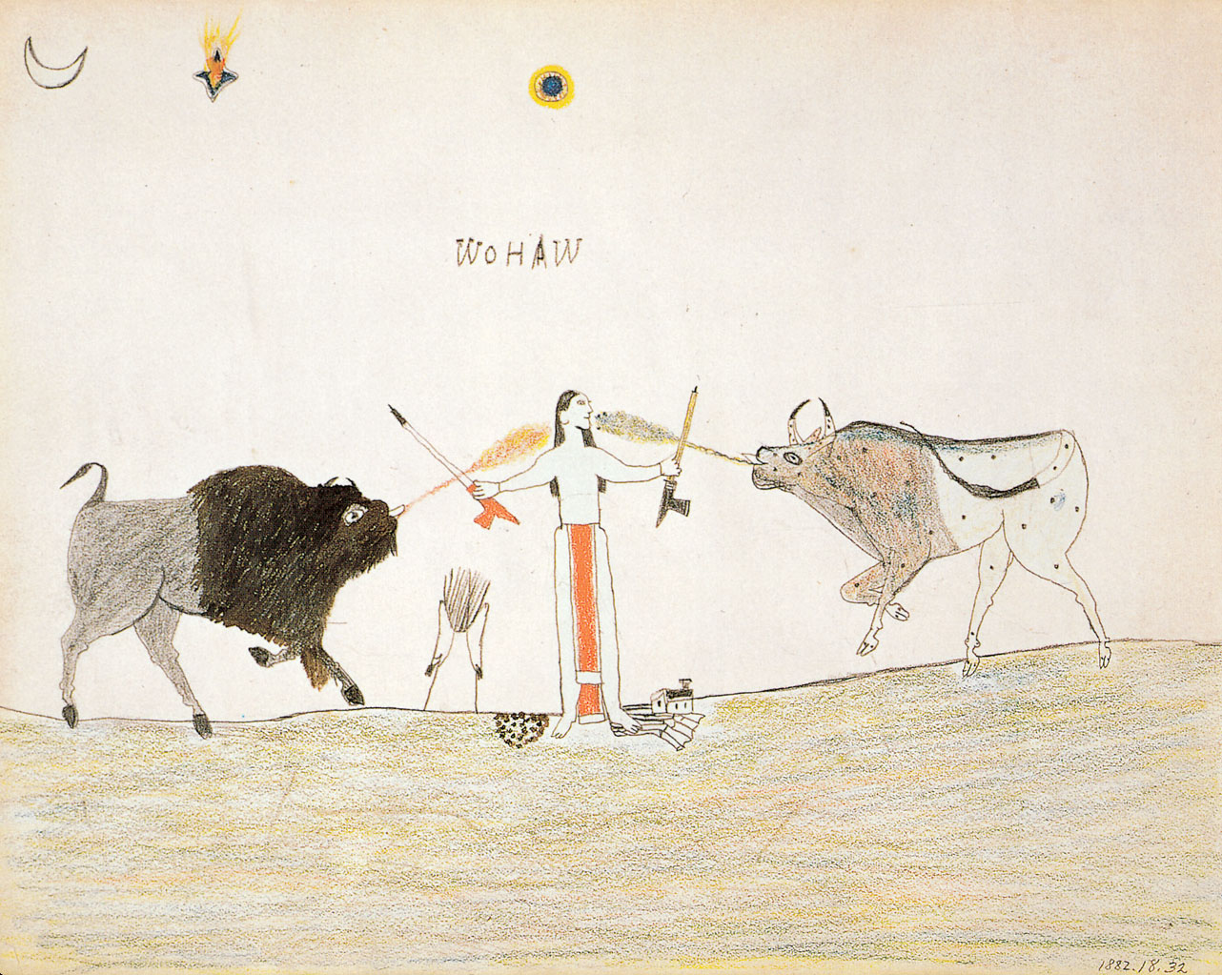
Wo-Haw, Wo-Haw Between Two Worlds
Made while Wo-Haw was imprisoned in Florida, along with 70 others (1875-1878)
Alleged crimes against white settlers
Wo-Haw is caught between two worlds

Slide 64
3.4.22 Wo-Haw, Wo-Haw between Two Worlds, 1877. Graphite and colored pencil on paper, 8½ × 11”. Missouri Historical Society, St. Louis.,

